Slide 1
STRUCTURE OF SCIENTIFIC DOCUMENTS
STW EX20003
UNIT 04
METHODOLOGY

Slide 2
METHODOLOGY – FRAMEWORK OF RESEARCH METHODS
Framework: Coherent set of concepts and relationships and body of methods and principles for
data collection and analysis,
model formulation, testing, and validation, and
theory development
Methodology: Framework, generally based on prevailing paradigm, that provides analytical foundation to answer set research questions

Slide 3
DEFENCE OF CHOSEN METHODOLOGY
Research credibility depends on appropriateness of methodology
Past works and researcher’s judgment play a great role
Alternative approaches:
Adopting existing approach
Doing minor/ major modifications of available approach
Adopting approach used in other discipline/ s
Developing completely new approach
Methodology should remain valid for assumptions made
Researcher has to outline strengths and positive features of chosen approach in preference to other alternative approaches

Slide 4
METHOD, TOOL, & TECHNIQUE
Method: Process of meeting specific objective e. g. hanging a picture on the wall
Tool: Artifact used in method e. g. hammer makes a dent in the wall
Technique: Lowest-level specific applying tool while using method e. g. Manner in which hammer and nail are held
Example 1
Operations research is a method
Linear programming is a tool
Simplex is a technique
Example 2
Simulation is a method
Discrete-event simulation is a tool
Random-number generation is a technique
Example 3
Questionnaire survey is a method
Questionnaire is a tool
Hypothesis testing of the survey results is a technique

Slide 5
QUALITATIVE RESEARCH METHODS IN SOCIAL SCIENCE
Ethnography, Grounded Theory, Phenomenology, Case Study, and Narrative Inquiry
Action Research is often considered as research method
Observation, Interview, Questionnaire survey, NGT, Delphi, and Focus Group Discussion are data collecting instruments (tools)

Slide 6
QUALITATIVE RESEARCH METHODS IN LITERATURE
Discourse Analysis
Textual Analysis
Hermeneutics
Ethnographic methods
Digital humanities
Creative research (performing arts and design)
Visual Methods: Films, TV, Graphic novels, Advertising etc.
Content analysis: Patterns in recorded communication (written, oral, visual), books, newspapers, magazines, speeches, interviews, web content, social media posts, photographs, films etc.
Archival methods: Archival records, recordings of conversations, memorabilia, postcards, photocopies, letters, bus tickets, newspaper clippings etc.
Biographical Research: microhistory recordings, interviews with authors, personal anecdotes etc.

Slide 7
TYPES OF METHODS
Quantitative: Static/ Dynamic, Deterministic/ Probabilistic/ Stochastic, Analytical/ Numerical, Linear/ Non-Linear, Open/ Closed
Mixed: Both qualitative and quantitative (ISM, AHP, Cross-Impact Analysis, Qualitative Simulation), Meta-analysis
Experimental: Laboratory, Field, Social, and Computer Simulation Experiments

Slide 8
WRITING STRATEGY
Start section by repeating objective of paper
Discuss about candidate methodologies
Defend choice of methodology and method(s) chosen
Provide logic of adopted method as
word description
flowchart
structured English
pseudocode and
algorithm
Provide details of method(s)

Slide 9
RESEARCH OBJECTIVES
RESEARCH METHODOLOGY
Collect Unit-wise Data on Performance and Carbon Di-oxide Emission
Examine effectiveness of PAT targets
Data Envelopment Analysis
Judge rationality of PAT normalization mechanism
Tobit Regression
Investigate influence of PAT scheme on investment in energy-efficiency technologies
Cash Flow Analysis
Monte Carlo Simulation
Decision Tree

Slide 10
BASIC CONSTRUCTS OF LOGIC FLOW
SEQUENCE: One task is performed sequentially after another
SELECTION:
IF-THEN-ELSE: Decision (selection) in which a choice is made between two alternative courses of action
CASE: Multi-way branch (decision) based on value of an expression
LOOP:
WHILE . . . DO: Loop (repetition) with simple conditional test in the beginning
REPEAT . . . UNTIL: Loop with simple conditional test at the end
FOR: ‘Counting’ loop

Slide 11
FLOWCHARTS
Basic symbols:
(1) ellipse – start or end of flow of logic
(2) square or rectangle – actions
(3) decision box (rhombus) – alternative decisions
(4) arrow – flow of logic
(5) circle – continuity of flow from one place to another

Slide 12
Start
Is it a textbook?
No
Yes
No
Are Funds Available?
Are Funds Available?
Yes
Yes
No
Wait list the book for the next
Waitlist book for next year
Buy the book
Buy the book
Return Reco. to HOD
Buy the book
End
FLOW CHART OF BUYING BOOKS FOR LIBRARY

Slide 13
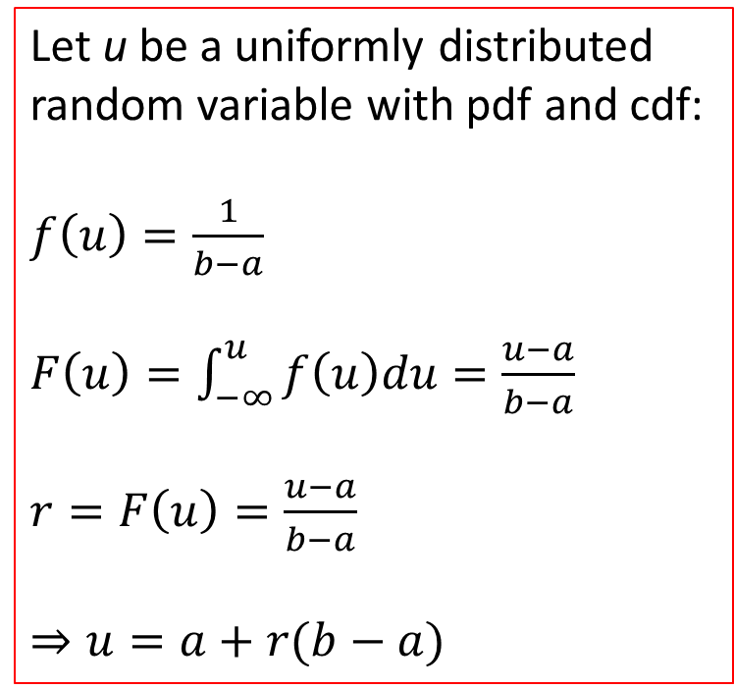
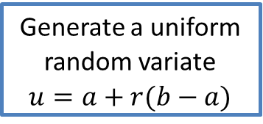
Generate 1000 uniform random variates U within numbers a = 10 and b = 20
Start
Count = 1, a = 10, b = 20
Generate a random number r
Count = Count + 1
Yes
Is
Count < 1000?
No
End

Slide 14
Structured English
Natural English written with the basic constructs of logic e. g. generate a uniformly distributed random variable varying between a and b
BEGIN
Count = 1
FOR Count = 1 to 1000
Generate random number r
Generate uniform random variate u = a + b (r – a)
Increment Count by 1
Print u
EndFOR
END
BEGIN
Count = 1
WHILE Count < = 1000
Generate random number r
Generate uniform random variate u = a + b (r – a)
Increment Count by 1
Print u
END

Slide 15
ALGORITHM
Algorithm is a finite set of instructions that, if followed, accomplishes a particular task
Features:
Input: Zero or more inputs externally supplied
Output: At least one quantity is produced
Definiteness: Each instruction is clear and unambiguous
Finiteness: Terminates after a finite number of steps
Effectiveness: Every instruction must be basic so that it can be carried out, in principle, by a person using only pencil and paper

Slide 16
Generate and print 1000 uniform random variates with minimum and maximum values as a and b
Uniform random variate
Input a, b
3 Count = 1
4 IF Count < =1000
5 Generate random number r
6 Generate uniform random variate u = a + b (r – a)
Increment Count by 1
Print u
9 EndIF

Slide 17
PSEUDOCODE
Find the largest of a series of numbers.
Algorithm LargestNumber
Input: A list of numbers L.
Output: The largest number in the list L.
if size of L= 0 return null
largest ← L[0]
for each item in L, do
if item > largest, then
largest ← item
return largest

Slide 18
THANK YOU!

